Slide 1
GPS Navigation System
ET 494 - Spring 2018
By: Dylan Landry, Jordan Melancon, & Miguel Rodriguez
Advisor: Dr. Koutsougeras
Professor: Dr. Koutsougeras

Slide 2
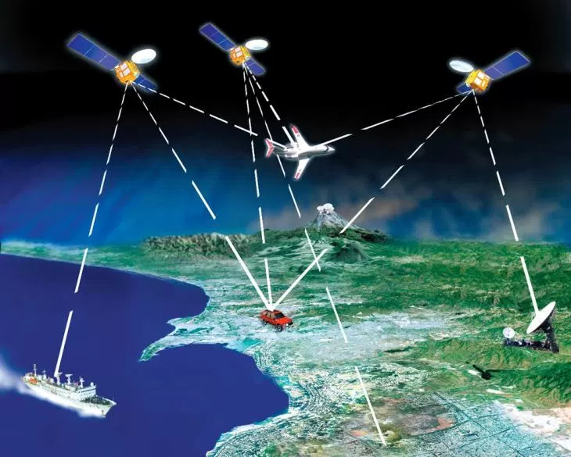
Introduction
Global Positioning System
Orbiting satellites transmit unique signals to GPS device
Device decodes signals and computes precise location
Current technology has integrated GPS into many motorized systems

Slide 3
Project Goals
The overall goal is to implement an applicable GPS navigation system. With minor hardware changes, this model can be applied to various motorized systems.
Ex: RC Car, RC Boat, Push Lawn Mower

Slide 4
Initial Work Plan
Figure out what parts we want to use
Learn how GPS gets coordinates
Design an interface to save and send coordinates
Learn how to link our interface and GPS with Bluetooth
Rewire and take control of RC car motors

Slide 5
Item | Cost
HC-06 Bluetooth Module | $8.99
Adafruit Ultimate GPS Breakout | $39.95
GMAXT RC Car | $70.99
Arduino Mega ADK | Free (normally $47.30)
5V GS-T DPDT Relay | $2.15 x 4
4N25 Optocoupler | $0.48 x 4
HC-SR04 Ultrasonic Sensor | $3.95
Total (before taxes + shipping) | $134.40

Slide 6
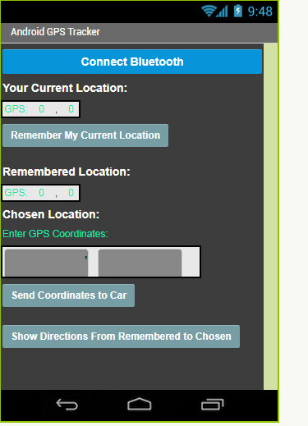
Mobile App
MIT App Inventor 2
Block Code
Simple Design
Real Time Testing

Slide 7
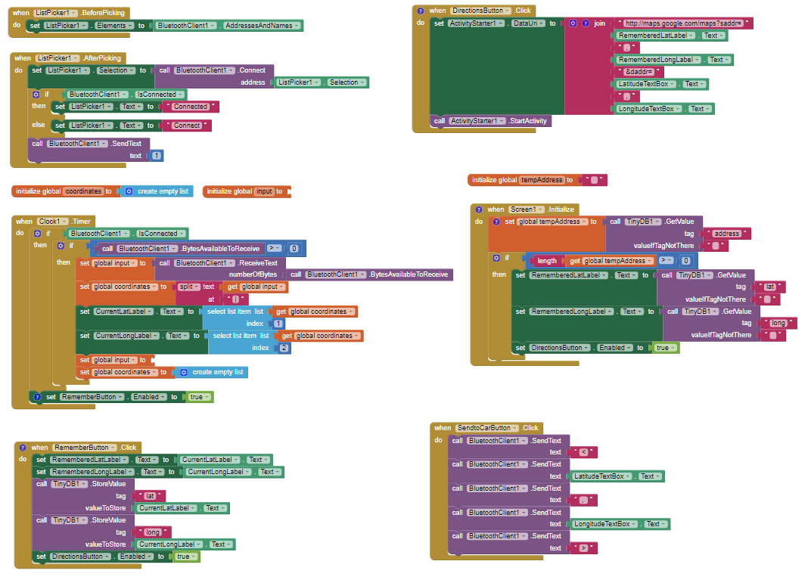
Mobile App
Setup
Interfacing with Bluetooth
Problems

Slide 8
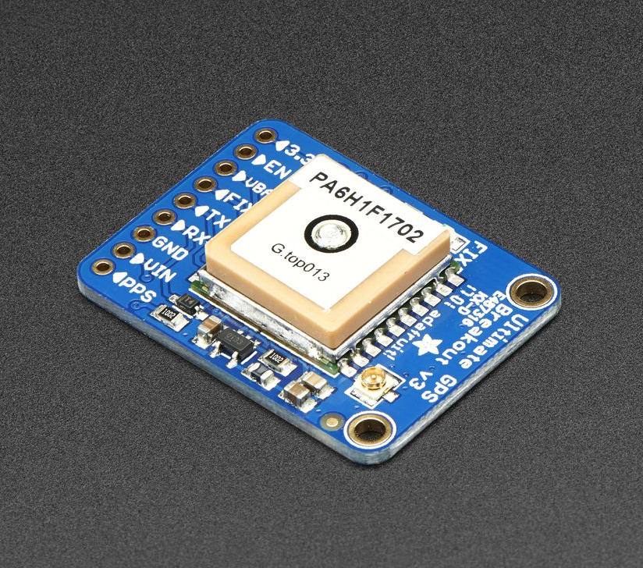
GPS Module
Adafruit Ultimate GPS Breakout
Built-in antenna (room for external antenna)
Accuracy within 3 meters (9.8 feet)
Adafruit GPS Library for Arduino¹

Slide 9
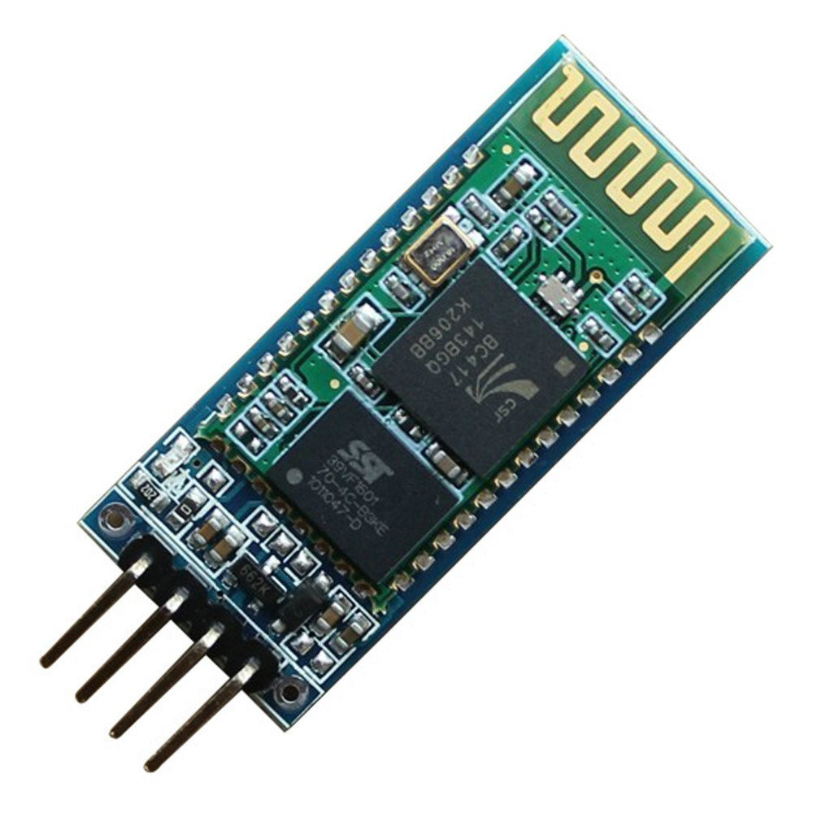
Bluetooth Module
HC - 06 Model
Range of 10 meters (32.8 feet)
Works on 9600 baud for Arduino
Interfacing with Arduino and GPS module
Bluetooth Parsing

Slide 10
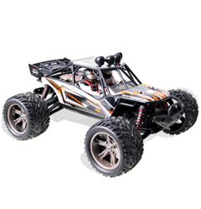
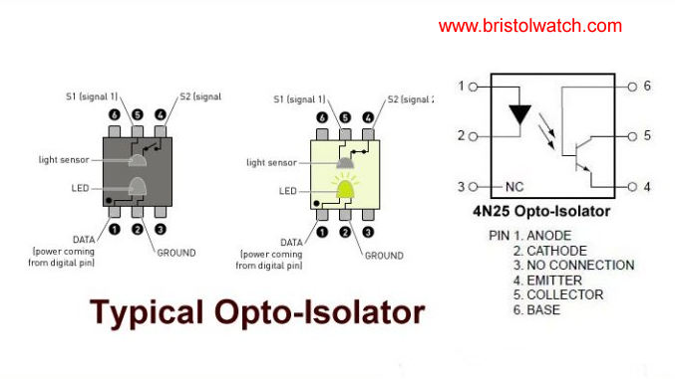
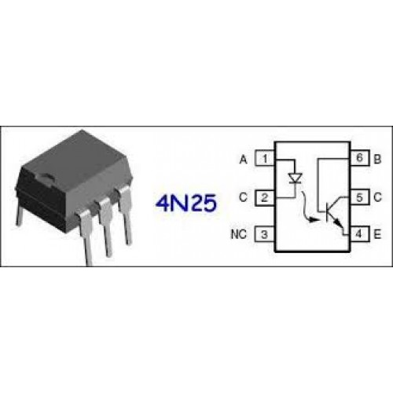
RC Car Motor Control
Motor Voltage Spike off
Motor control protective Circuit
Typical Optocoupler:

Slide 11
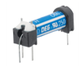
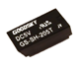
RC Car Motor Control cont.
Relays (5v dc reed SPST )
Bi-directional Motor Control Circuit
Combination of optocoupler (4N25) and relays (5v GS-T DPDT)
Hardware setup -- ready to ensemble the system.
Bypass factory Controllers.
RC car made easy to access wiring for ensembling and future modification.

Slide 12
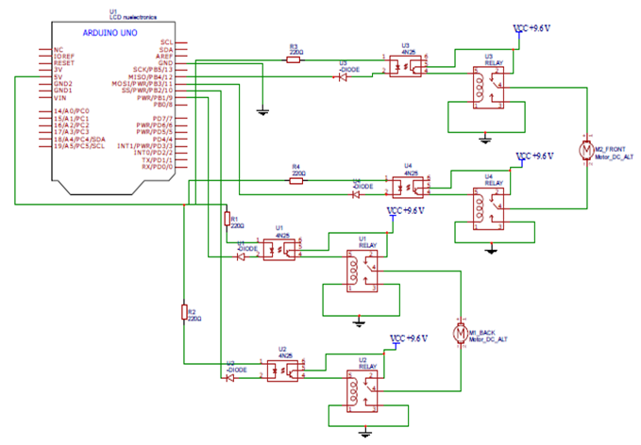
Circuit Control Schematic

Slide 13
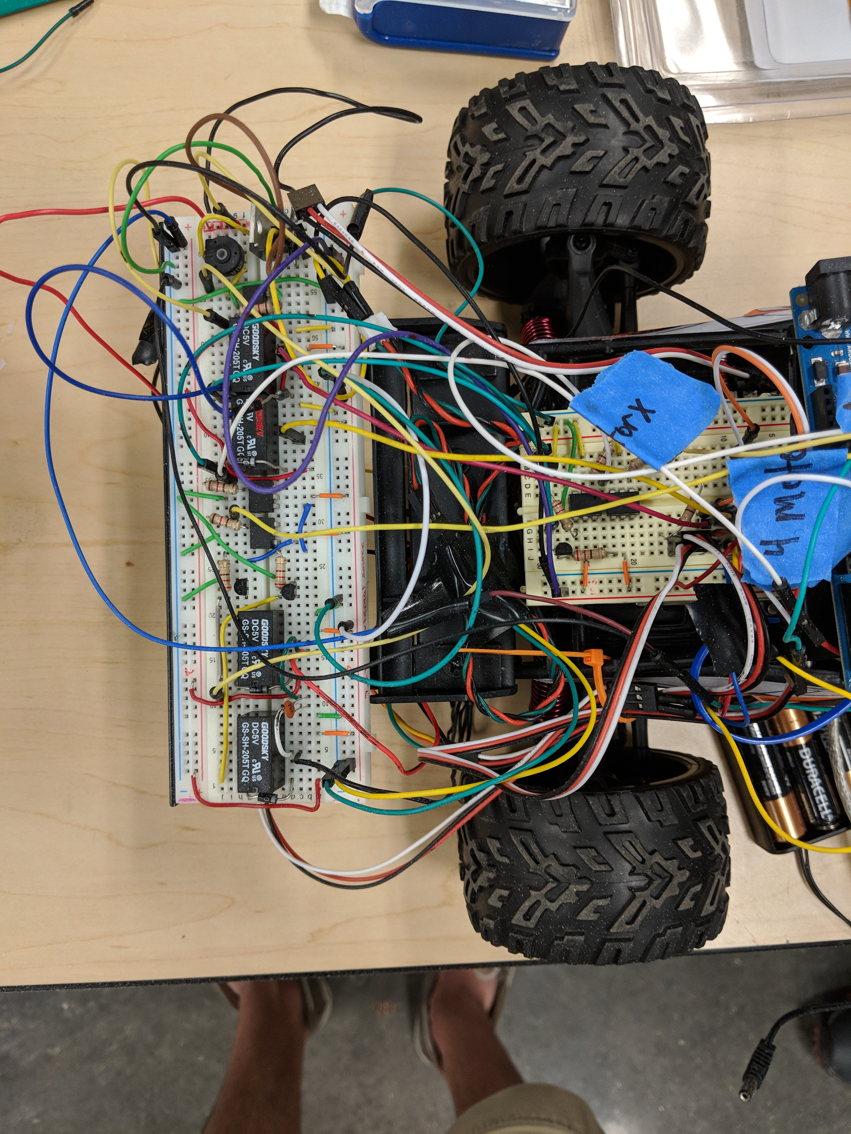
Fine Tuning & Troubleshooting Motor Control
Voltage spikes caused component failure
Replacement of potentiometer reading
Tuning and testing the power modulation for speed control
Limited space for the circuit and other components

Slide 14
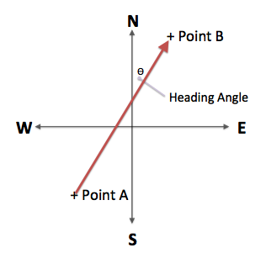
Improving GPS
Trimmed down full GPS code
All calculations run in its own function
Addition of heading angle

Slide 15
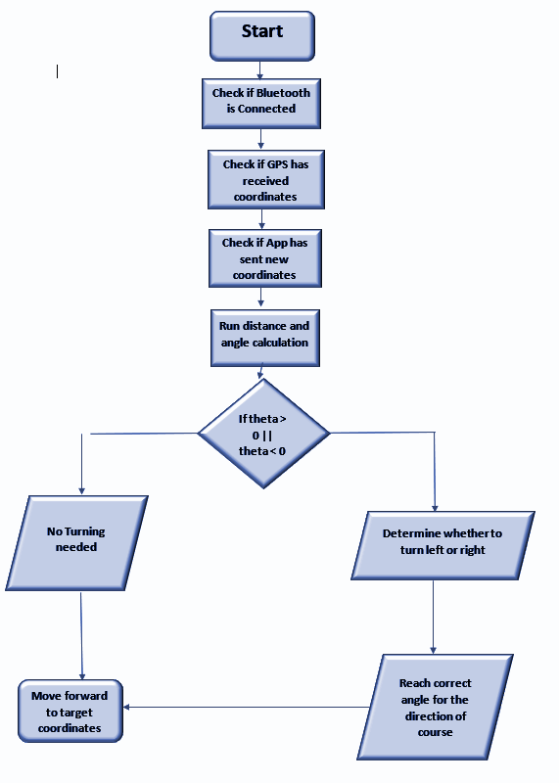
Logic Flowchart

Slide 16
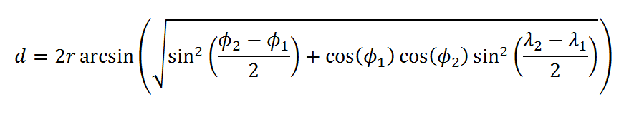
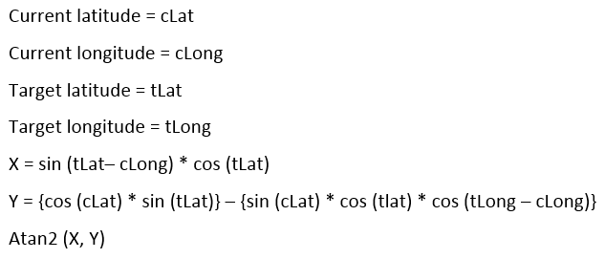
Navigation Calculations
Distance Calculation
Haversine Formula
Why is this needed?
Angle calculation
Why is this needed?

Slide 17
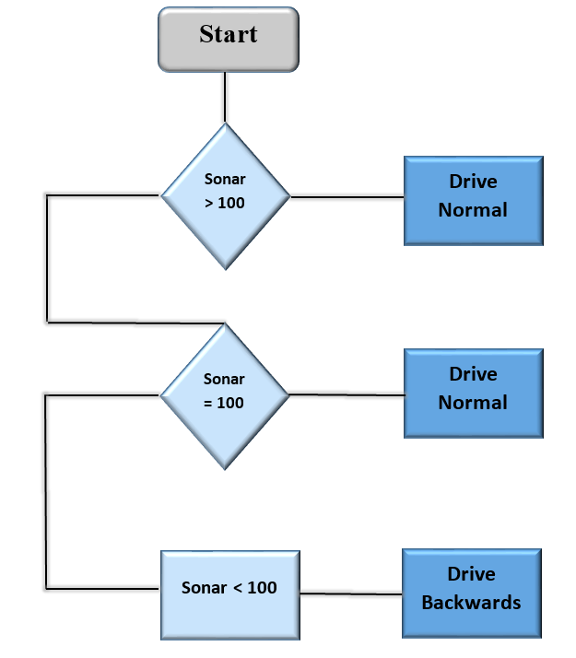
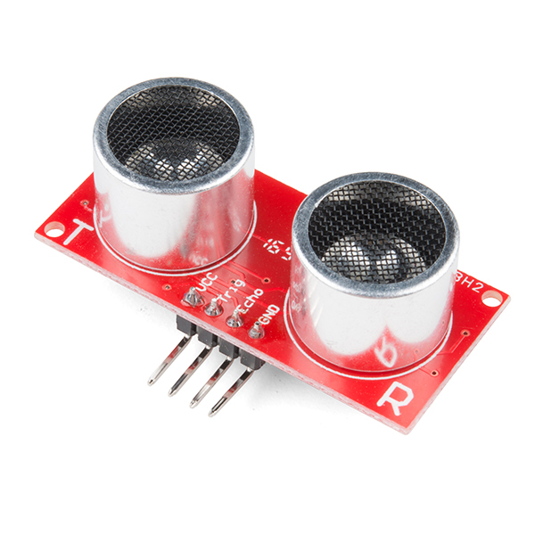
Obstacle Detection and Avoidance
HC-SR04 Ultrasonic Sensor
Moving Average
Avoidance system

Slide 18
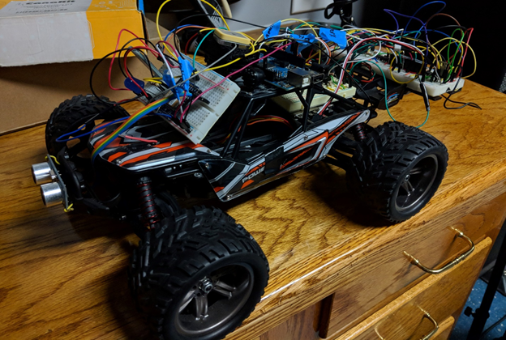
Final Build

Slide 19
Overall Accomplishments
Design an app in which you can input your desired location to the GPS system
We added GPS calculations such as distance and angle equations so that we can find our current distance and degree angle from our target location.
Setup the GPS module to output coordinates to and from the app
Improved our sending and receiving of GPS coordinates from the app to the Arduino.
Be able to direct the RC vehicle the direction it needs to go based on the coordinates
RC car also now has full control for forward, backward, right, and left.
Completely implement our GPS system with the motor control.

Slide 20
Sources
HC-06 Bluetooth Module:
https://www.amazon.com/Pass-Through-Communication-Compatible-Atomic-Market/dp/B00TNOO438
Breakout GPS Module:
https://www.adafruit.com/product/746?gclid=EAIaIQobChMI-PvqyNzi1wIVgR2BCh2GjQb4EAAYASAAEgKHfPD_BwE
GMAXT RC Car:
https://www.amazon.com/GMAXT-Remote-Control-off-road-Vehicles/dp/B073Z29RW9
Arduino Mega ADK:
https://store.arduino.cc/usa/arduino-mega-adk-rev3
5v GS- T DPDT Relay
https://www.rapidonline.com/good-sky-gs-sh-205t-5v-dpdt-subminiature-relay-60-4754
4N25 Optocoupler:
http://www.bristolwatch.com/ele/opto_isolated.htm
5v DC Reed SPST Relay
https://www.radioshack.com/products/spst1a-5vreed-rly
HC-SR04 Ultrasonic Sensor
https://www.sparkfun.com/products/13959

Slide 21
References
1.) Arduino Wiring | Adafruit Ultimate GPS | Adafruit Learning System. (n.d.). Retrieved from
https://learn.adafruit.com/adafruit-ultimate-gps/arduino-wiring
2.) haversine-geolocation. (n.d.). Retrieved from
https://www.npmjs.com/package/haversine-geolocation 3.) Material Design. (n.d.). Retrieved from
https://material.io/

